Slide 1
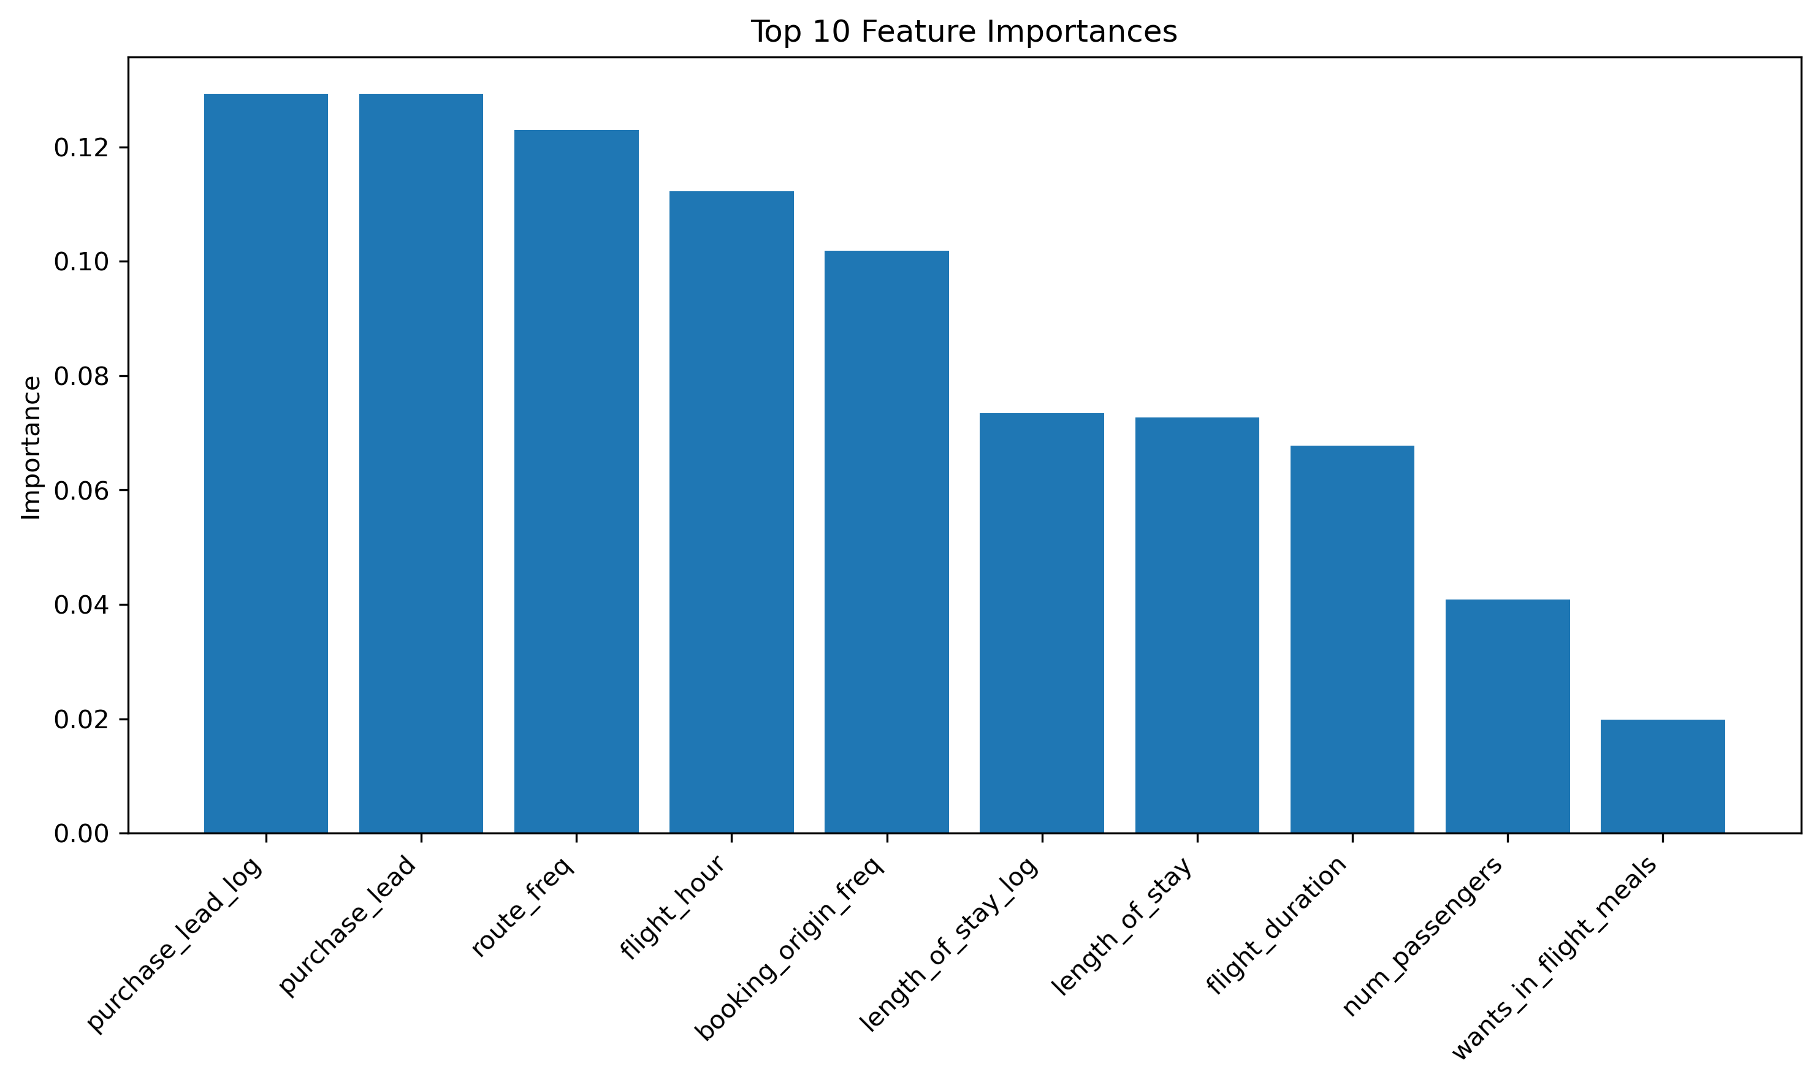
Predicting Customer Booking Behavior
Model Summary & Key Findings
A Random Forest model trained on 50,000 customer booking records achieved 86% accuracy. The model excels at identifying non-bookers but struggles with actual bookers due to class imbalance.
MODEL INFORMATION
Algorithm: Random Forest Classifier
Dataset Size: 50,000 customer booking records
Features: 14 original + engineered features (log transformations)
Training/Test Split: 80/20 with stratification
METRIC | VALUE | INTERPRETATION
Overall accuracy | 86% | Strong overall performance
Precision (Booked) | 0.63 | 63% of predicted bookers are correct
Recall (Booked) | 0.09 | Only 9% of actual bookers captured
F1-Score (Booked) | 0.16 | Low due to recall issue
KEY FINDINGS:
Top 3 Predictive Features:
Purchase Lead Time (Log) - Importance: 0.133
Purchase Lead Time (Raw) - Importance: 0.131
Route Frequency - Importance: 0.124
Model Performance:
Excellent at identifying non-bookers (99% recall)
Poor at capturing actual bookers (9% recall)
Class imbalance issue: 85% non-bookers vs 15% bookers
Business Insight:
When customers book matters more than who they are
Early lead identification is critical
RECOMMENDATIONS:
Use model to reduce marketing spend on unlikely customers
Focus on timing-based targeting (purchase lead time is key)
Improve model: Apply data balancing (SMOTE), adjust decision threshold
Future testing: Try XGBoost or LightGBM for better recall on bookers
CONFUSION MATRIX
Predicted: No Predicted: Yes
Actual: No 8,422 82
Actual: Yes 1,359 137
✓ Correctly identified non-bookers: 8,422
✗ Missed actual bookers: 1,359 (major issue)
CROSS-VALIDATION RESULTS (5-Fold):
Fold 1: 0.8620 | Fold 2: 0.8610 | Fold 3: 0.8605 | Fold 4: 0.8615 | Fold 5: 0.8625
Mean CV Accuracy: 0.8615 (±0.0007)
→ Model performs consistently across all folds (no overfitting detected)

